Slide 1
Test your
Business Viability
B. Díaz
27 de septiembre, 2019

Slide 2

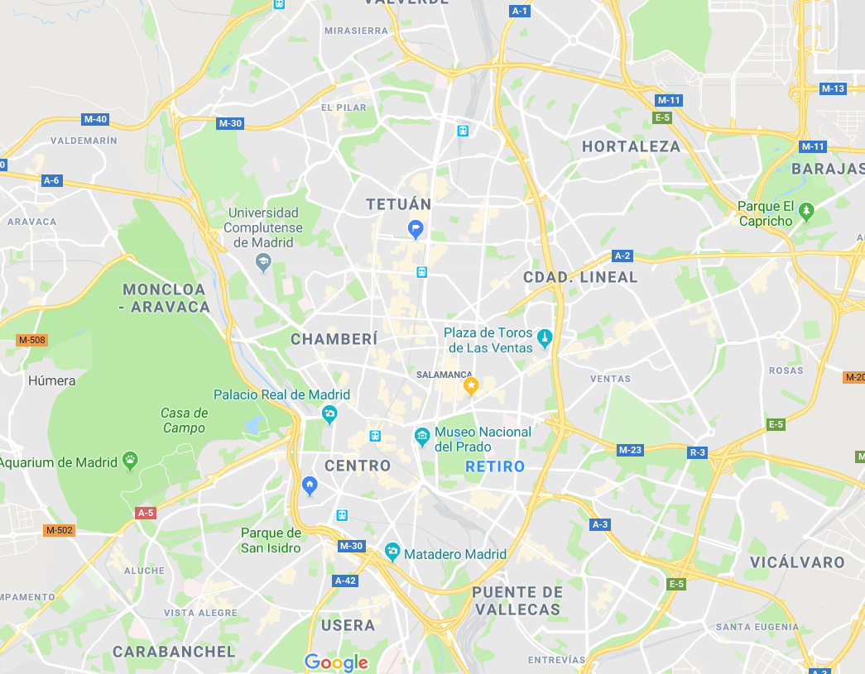

Idea
You have a great idea for a business in Madrid. But before you invest your time, capital and resources, you need to figure out whether it’s a viable business venture.
Via analytics, we will try to answer the following questions:
Descriptive questions:
understand the impact of population in a business, weekly/weekends
Typify zones (postal codes) and representative variables
Identify a business influence zone
Predictions:
Probability of a businesses to remain opened the year after the opening
Type of Business with the highest probability to remain opened the year after in a zone
Bakery
Gym
Hairdressers
Icons made by https://www.flaticon.com/

Slide 3



Motivation
In my neighborhood there are locals that have housed a different business every year, sometimes even more than two per year. I have always wondered whether people, mainly self-employees with limited resources, make a proper business viability study prior to invest in their ideas or passions.
For me it is a pity the effort and hopes that many people squander in a business that lasts less than 3 months.
Make use of Madrid public data to help entrepreneurs in Madrid to decide whether to start a new business or not, which one and where

Slide 4

Some statistics
95% of the business are microSMEs (self employees and less than 9 employees)
22,4% of the businesses are retailers with a 96% of micropymes penetration
Retailers represent the biggest businesses destruction (8 k business less YoY)
Quotes for illustration purposes only
Source: ipyme.org/Retrato de la pyme. Datos a 1 de enero de 2018

Slide 5



Main datasets
Censo de locales
Portal de datos de madrid.es:
Datos desde 2014 hasta 2018
Formato csv (fichero/año)
Id. Local
Distrito
Actividad
Estado
>5 Millones registros/año
Catastro
Portal de datos de madrid.es:
Datos desde 2013 hasta 2017
Formato csv (fichero/año)
Distrito
Tipo inmuebles
Número inmuebles
Valor catastral
24k registros/año
Padrón
Portal de datos de madrid.es (banco de datos)
Datos desde 2014 hasta 2018
Formato excel/csv
Población x distrito, barrio, edad, género, nacionalidad, educación
Gasto anual a nivel Ciudad Madrid x edad, género, educación
Turismo
Madrid.es y Inside Airbnb
Airbnb Listings (2019)
Airbnb Reviews (since 2011)
Oficinas de turismo
Tiendas con perfil turístico (xml)
Puntos de interés turístico (xml)
Tráfico / zona
TBC (NDA)
Estimación de movimientos de personas/zona/día de la semana
Anonimizada/agregada

Slide 6

Modeling Methodology: MPV
Probability of a businesses to be success
Type of model: binary classification problem
Target variable: Success business = business opened in Madrid the year after the opening year
Independent variables: type of business, variables that typify a zone (traffic, tourism, sociodemographic characteristics), area of influence of a business (distance between equivalent businesses),
Decisions to take after the first exploratory phase:
Type of business to include in the model based on sample size, baseline/fashion to assure stability
socio demographic variability yoy
Train different models: logistic regression, random forest, XGboost
Test & sensitivity
Metrics: AUC, precision
Most probable type of business to be success in a zone
Predict per type of business/zone
Order prob. per type of business/zone

Slide 7
Project Methodology & Main Milestones
Sept. 27th
Oct. 28th
Nov. 29th
MVP
Oct. 7th
Nov. 18th
Ph. 0: Confirm idea (10h)
Other ideas?
Solve doubts
Ph. 2: Database, exploratory and descriptive phase (30h)
Prepare data in a single database, feature engineering
First exploratory data analysis, descriptive
MVP: Results (10h)
Main insights
Conclusions
TFM documentation
Ph.1: Data gathering (10h)
Download all the datasets
Select type of businesses
Ph. 3: model and insights (iterative phase) (20h)
Prepare model: train, CV, Gridsearch, test, performance
Test sensitivity
Firsts Insights
Future increments:
New model: Most probable type of business (multiclass)
Extend to all businesses
App tool

Slide 8


Next steps
Clarify doubts:
Error: EmptyDataError: No columns to parse from file (fichero padron)
Project doubts tutoring methodology
Data gathering and type of business selection (Due date: October 7th)
Look for the 5Js shop closest to my neighborhood
Follow the project in: https://github.com/bdiazcor/Kshool-TFM-/

Slide 9
Appendix

Slide 10
Main datasets
Datos.gob.es (nivel estatal)
Censo de edificios por tamaño de población: 01008c.csvFecha ¿?
Censo de edificios e inmuebles/pobalción: 1mun00sc.csv: censo de edificios e inmuebles/pobalción. Fecha ¿?
Compraventa de viviendas desde 2007 hasta 2018, por comunidad autonoma y provincia. 6155sc.csv. Interesante
Empleo total y asalariado Resultados por provincias ramas de actividad magnitud y periodo (Identificador API: /t35/p010/base2010/l0/02002.px): 02002sc.csv. Años 2012-2016. No muy claro
Nacimientos por comunidades y ciudades autónomas de residencia de la madre y mes. Movimiento Natural de la Población Resultados Provisionales (Identificador API: /t20/e301/provi/l0/01005.px):01005sc.csv. Só 2019
Censo de locales
https://datos.madrid.es/sites/v/index.jsp?vgnextoid=23160329ff639410VgnVCM2000000c205a0aRCRD&vgnextchannel=374512b9ace9f310VgnVCM100000171f5a0aRCRD-> histórico de locales desde 2014
Viviendas turísticas: Seccion: I, Division 55
Padron de madrid, edad, sexo, inmigrantes, movimientos
Datos 2018: https://www.madrid.es/portales/munimadrid/es/Inicio/El-Ayuntamiento/Estadistica/Areas-de-informacion-estadistica/Demografia-y-poblacion/Cifras-de-poblacion/Padron-Municipal-de-Habitantes-explotacion-estadistica-/?vgnextfmt=default&vgnextoid=e5613f8b73639210VgnVCM1000000b205a0aRCRD&vgnextchannel=a4eba53620e1a210VgnVCM1000000b205a0aRCRD
Histórico desde 2014: https://datos.madrid.es/sites/v/index.jsp?vgnextoid=5deb7700f69e8410VgnVCM2000000c205a0aRCRD&vgnextchannel=374512b9ace9f310VgnVCM100000171f5a0aRCRD
Banco de datos Madrid.es (si no encuentro algo): http://www-2.madrid.es/CSE6/control/menuCSE
- Gasto anual por educación, sexo, hogar, a nivel de Madrid
INE: Proyecciones de población y de hogares (hasta 2068) http://www.ine.es/dyngs/INEbase/es/categoria.htm?c=Estadistica_P&cid=1254734710984
Proyecciones de población y de hogares
Catastro - datos desde 2013
https://datos.madrid.es/portal/site/egob/menuitem.c05c1f754a33a9fbe4b2e4b284f1a5a0/?vgnextoid=3ed1854c8410b410VgnVCM2000000c205a0aRCRD&vgnextchannel=374512b9ace9f310VgnVCM100000171f5a0aRCRD&vgnextfmt=default
Turismo
Airbnb:
http://insideairbnb.com/get-the-data.html
10 July, 2019 Madrid listings.csv.gz Detailed Listings data for Madrid
10 July, 2019 Madrid calendar.csv.gz Detailed Calendar Data for listings in Madrid
10 July, 2019 Madrid reviews.csv.gz Detailed Review Data for listings in Madrid
10 July, 2019 Madrid listings.csv Summary information and metrics for listings in Madrid (good for visualisations).
10 July, 2019 Madrid reviews.csv Summary Review data and Listing ID (to facilitate time based analytics and visualisations linked to a listing).
N/A Madrid neighbourhoods.csv Neighbourhood list for geo filter. Sourced from city or open source GIS files.
N/A Madrid neighbourhoods.geojson GeoJSON file of neighbourhoods of the city.
Tiendas con perfil turistico en Madrid
https://datos.madrid.es/sites/v/index.jsp?vgnextoid=86e3a73970504510VgnVCM2000001f4a900aRCRD&vgnextchannel=374512b9ace9f310VgnVCM100000171f5a0aRCRD
https://www.esmadrid.com/opendata/tiendas_v1_es.xml
Oficinas de turismo:
https://datos.madrid.es/sites/v/index.jsp?vgnextoid=7240e6bffbfe5410VgnVCM1000000b205a0aRCRD&vgnextchannel=374512b9ace9f310VgnVCM100000171f5a0aRCRD

Slide 11
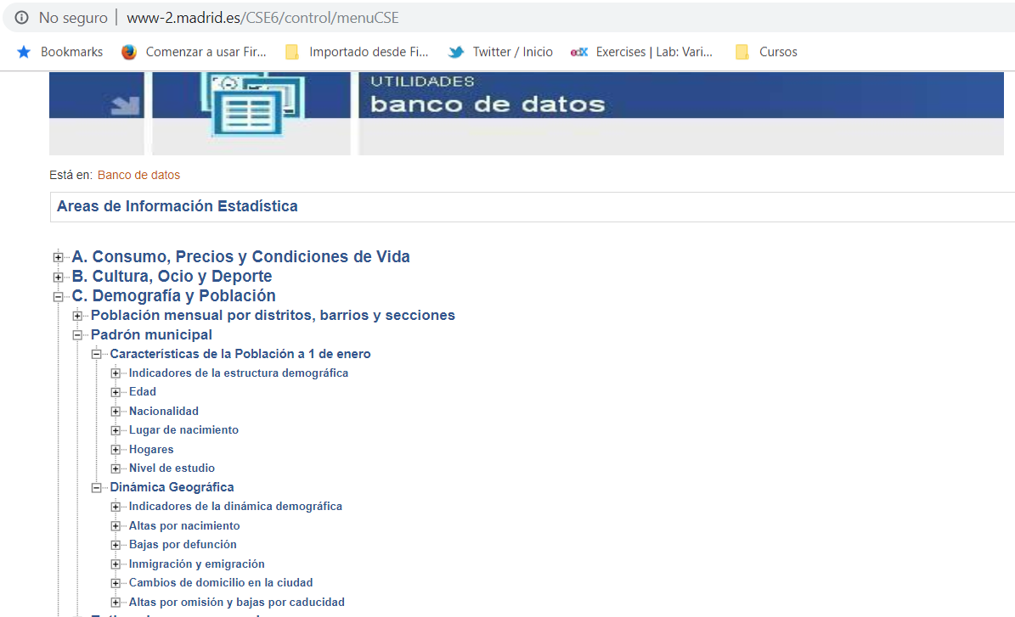
Detail Data bank (for municipal register)

Slide 12
Modeling Methodology
Most probable type of business in a zone in a zone
Strategy 1 (MPV):
Model 1 including type of business
Predict per type of business
Order
Strategy 2:
New model: multiclass classification model
Target variable: type of business with highest prob to be success
Prob.
Prob. of business Type 1 to be success
Prob. of business Type 2 to be success
Prob. of business Type n to be success
Prob. to be success
type of business with highest prob.

